Slide 1
BELL RINGER
What are some of the laws that you’ve encountered recently?
Who makes sure that people follow laws?
How are rules different than laws?

Slide 2
PRIMARY OR SECONDARY?
Think back to last class and the difference between primary and secondary sources.
A photograph of you and your friends from your 8th birthday party.
The information from a museum tour guide who shows you around the museum and shares facts with you.

Slide 3
RULE OF LAW
What are rules/laws?
Who must follow rules/laws? Why?
Why do rules/laws exist?
What are the consequences of not having rules/laws?

Slide 4
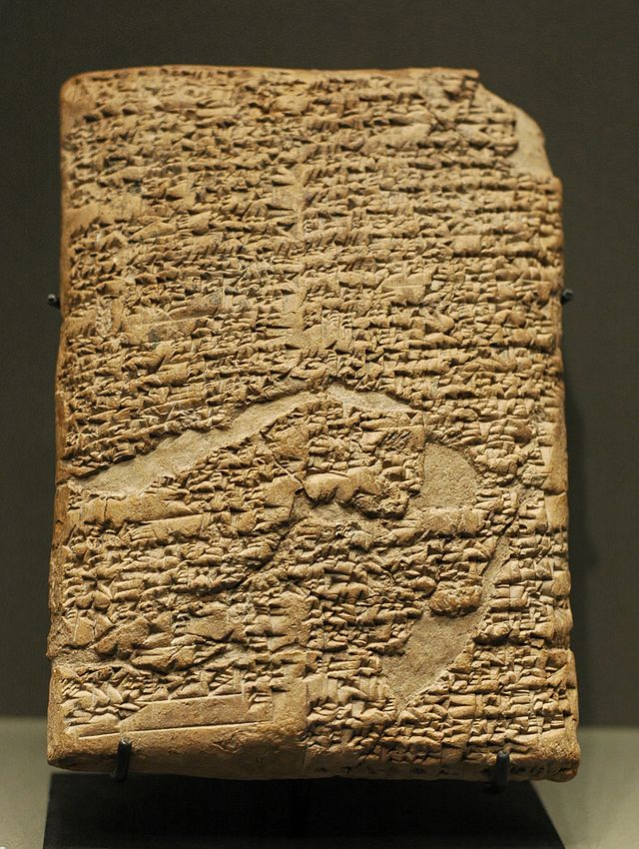
WHAT IS A LAW?
A law is a rule for
society.

Slide 5

RULE OF LAW
RULE OF LAW
RULE OF LAW means that:
No one is above the law
Everyone must follow the law
The law applies equally to everyone
We are a country of laws, not of men
Laws and procedures are transparent and fair

Slide 6
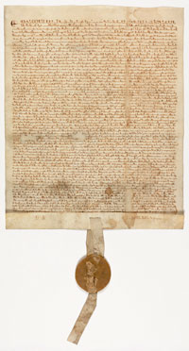
WHERE DID THE RULE OF LAW ORIGINATE?
The Rule of Law was first found in Magna Carta, 1215
This document, signed by King John, stated that even the king had to follow the laws.

Slide 7
PRINCIPLES OF THE RULE OF LAW
The Rule of Law has a huge impact on our government officials and institutions, from how they are held accountable (responsible) to how decisions are made to how laws are enforced!
Four Principles of the Rule of Law
Principle 1
Principle 2
Principle 3
Principle 4
Accountability to the law
Decisions based on the law
Fair procedures
Consistent application

Slide 8
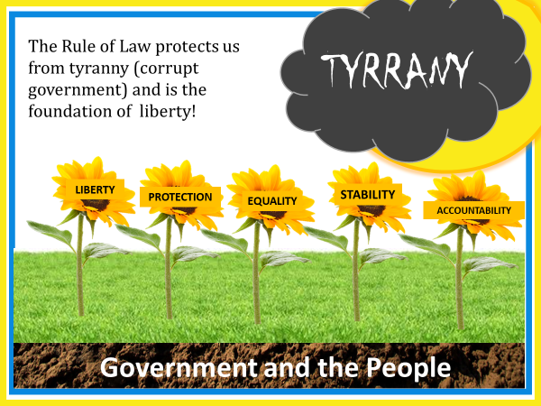
WHERE DID THE RULE OF LAW ORIGINATE?
The Rule of Law was first found in Magna Carta, 1215
This document, signed by King John, stated that even the king had to follow the laws.

Slide 9
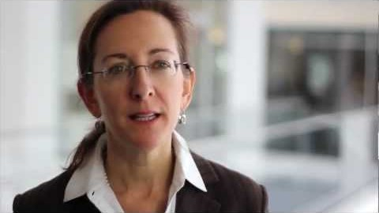
RULE OF LAW

Slide 10
CLASSWORK
Go to the assignments tab and click on the Word doc. There are two sections to complete.
Section 1: Video
Section 2: Rule of Law thought Q’s

